Slide 1
Big Data – Definitional Aspects

Slide 2
Characteristics of Big data
Gartner’s 3V casted by Douglas Laney in 2001
Volume , Velocity and Variety
IBM’s 4V casted by Zikopoulos in 2012
Volume , Velocity , Variety and Veracity
Yuri Demchenko’s 5V in 2013
Volume , Velocity , Variety , Veracity and Value
Microsoft’s 6V in 2014
Volume , Velocity , Variety , Veracity , Value and Visibility
Volume: Refers to the vast amount of data generated every second. Velocity: The speed at which new
data is generated and moves around. Variety: The different types of data (structured, unstructured, etc.).
Veracity: The uncertainty of data, which refers to the quality and trustworthiness of the data.
Value: The worth or benefit that can be derived from the data, focusing on its business impact.
Visibility: The ability to ensure that data is accessible and understandable to those who need it.

Slide 3
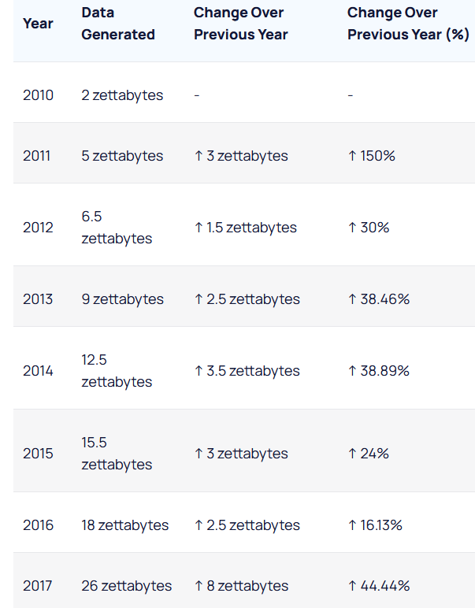
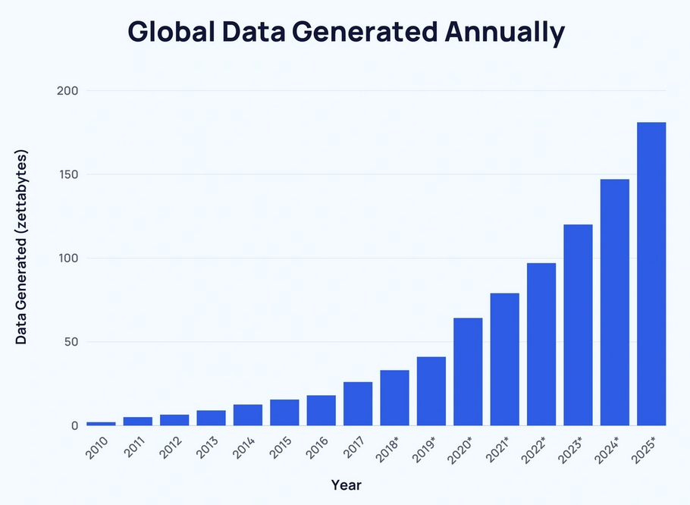
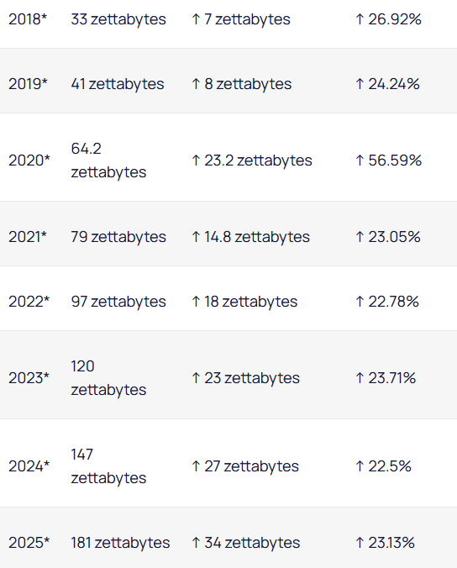
Volume
Reference: https://explodingtopics.com/blog/data-generated-per-day

Slide 4
Volume in the context of big data refers to the massive amount of data that is generated every second from a wide range of sources.
Case Study Example: Social Media Platforms
Background
Social media platforms like Facebook, Twitter, and Instagram generate enormous volumes of data every day. Users create data through posts, likes, comments, shares, and uploads, contributing to a constantly growing data pool.
Facebook: As of 2023, Facebook had about 3.07 billion monthly active users. The platform handles massive volumes of data daily, including text posts, images, videos, likes, shares, and comments. It's estimated that Facebook processes approximately 4 petabytes of data every day​
Twitter: Twitter users send an average of 500 million tweets per day. With approximately 368 million monthly active users as of 2023, the platform generates a significant volume of text-based data
Instagram: Instagram has over 2 billion monthly active users as of 2023. The platform is primarily driven by visual content, with users posting millions of photos and videos daily​
YouTube: YouTube, with over 2.7 billion monthly active users, is one of the largest video-sharing platforms. Users watch over 1 billion hours of video each day, and around 500 hours of video are uploaded every minute​

Slide 5
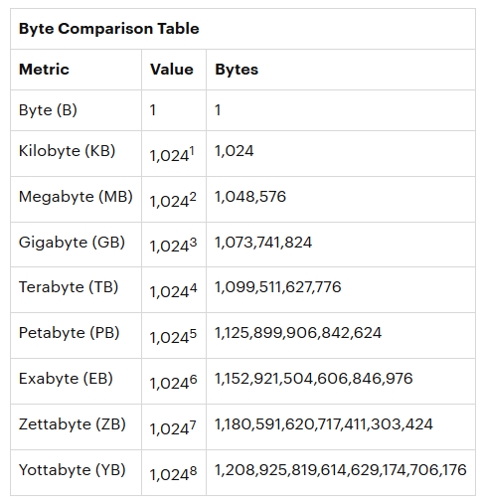

Slide 6
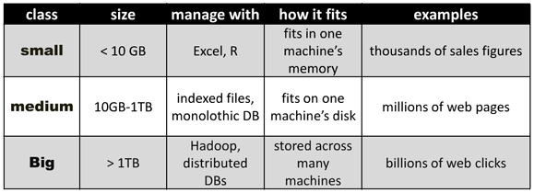

Slide 7
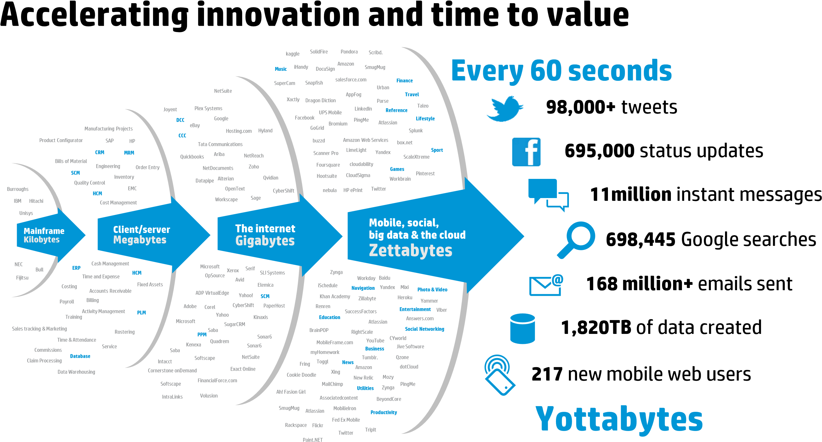
Velocity
velocity refers to the speed at which data is generated, collected, and analyzed.
It highlights the need to process and analyze data quickly as it flows in, enabling timely decision-making and insights.
Taken from : Hewlett-Packard Development Company “truths and myths about big data”,2013

Slide 8
Case Study: Uber's Use of Big Data Velocity
Key Components
Real-Time Ride Matching
Process: Uber uses high-velocity data to match riders with drivers in real time. The system analyzes data from various sources, including GPS signals, user requests, and traffic conditions, to ensure efficient ride allocation.
Impact: This ability to quickly match riders with nearby drivers reduces wait times and improves the overall user experience, making Uber a preferred choice for many users.
Dynamic Pricing (Surge Pricing)
Process: Uber's dynamic pricing model is driven by real-time data. The company continuously monitors demand and supply conditions across different locations and times. When demand exceeds supply, prices increase automatically to incentivize more drivers to become available.
Impact: This strategy helps balance the demand-supply equation, ensuring that riders can still find rides during peak times while allowing drivers to earn more.
Solution
Stream Processing
Tools Used: Apache Kafka, Apache Flink, Apache Storm, and Apache Spark Streaming are commonly used tools for stream processing. These tools enable real-time processing of data streams by handling high-throughput and low-latency data ingestion and processing.
Functionality: Stream processing allows Uber to process incoming data continuously, such as GPS locations and ride requests, without storing them first. This enables instant analysis and decision-making, crucial for real-time ride matching and dynamic pricing.

Slide 9
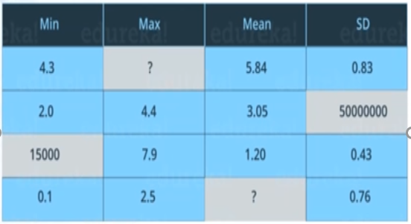
Veracity
It deals with the uncertainty, inconsistencies, and inaccuracies that can exist within data sets.
Ensuring data veracity is crucial because decisions and insights derived from data are only as reliable as the data itself.
Inconsistent Values:
One row has a mean value of 1.20, which seems inconsistent with its minimum value of 15,000. This could indicate a data entry error or an anomaly in the data collection process.
Uncertainty in Data:
There are missing values (e.g., missing maximum and mean values in some rows), which can lead to uncertainty in analysis and decision-making.
Extreme Variations:
A standard deviation (SD) value of 50,000,000 is extremely high compared to the other values in the same row, suggesting a possible data anomaly or incorrect calculation.

Slide 10
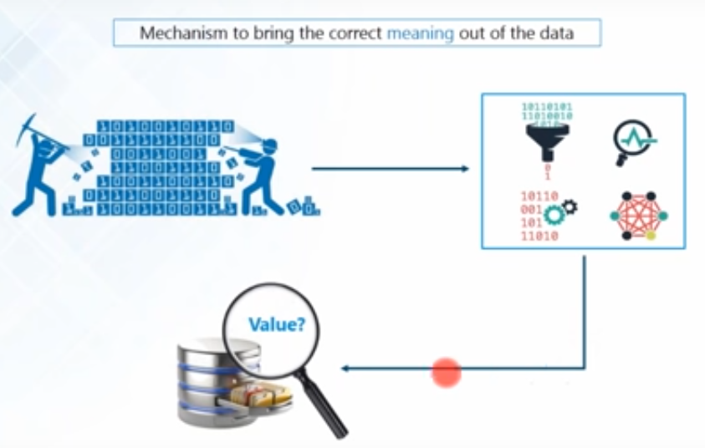
Value
value in big data refers to the process of extracting meaningful insights and benefits from vast amounts of data. ‘
Transformation of raw data into actionable insights that can drive business decisions, enhance customer experiences, improve operations, and create competitive advantages.

Slide 11
Examples of Value Extraction
Retail: Companies like Amazon use big data to personalize shopping experiences, optimize pricing strategies, and manage inventory efficiently.
Healthcare: Big data analytics is used to predict disease outbreaks, personalize treatments, and improve patient care through analysis of medical records and real-time health data.
Finance: Financial institutions use big data for fraud detection, risk management, and customer analytics to offer tailored financial products and services.
Transportation: Companies like Uber and logistics firms use big data to optimize routing, improve delivery times, and enhance fleet management.

Slide 12
What is big data about?
Answers are often “too big to ….”
Load into memory……..…Store on a hard drive…….…Fit in a standard database
“Fast changing”………..Not just relational
“Digital breadcrumbs” left behind (communication transactions..)—Hard little data particles left behind as people go about their daily lives
Open web data/social media data (facebook, twitter, blogs, online news, videos….)
Remote sensing (satellite, meters…)

Slide 13
What is big data about - and not about?
“Big Data is not about the data” (Gary King)
Institute for social science ,Harvard university
It’s about the analytics—the insights gleaned from the data; and the necessary capacities to do so—human, technological
One step further: it’s about knowledge: getting near to the ‘true’ meaning of a facebook status update;
It’s about sharing and diffusion – visualizations

Slide 14
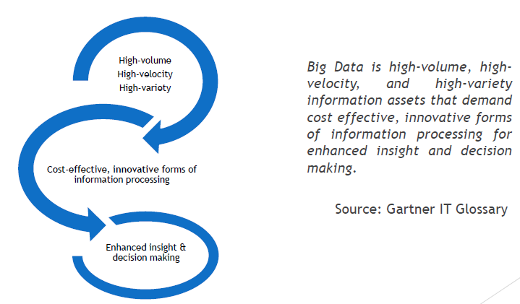
Big data Definition

Slide 15
Challenges with Big data

Slide 16
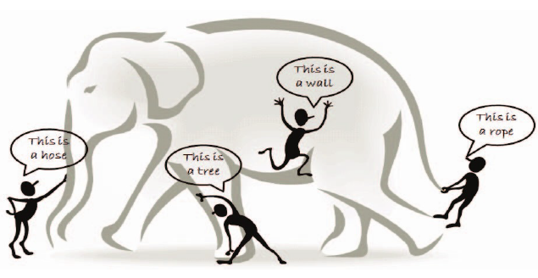
Notes:
The Blind Men and the Elephant - Once upon a time, four blind men wanted to understand what an elephant was. Since they couldn’t see, they decided to touch the elephant and describe it based on what they felt.
The first man touched the trunk and said, “This is a hose.”
The second man touched the leg and said, “This is a tree.”
The third man touched the side of the elephant’s body and said, “This is a wall.”
The fourth man touched the tail and said, “This is a rope.”
Each man was convinced he was correct, but they were all only partly right. They started arguing, each believing his own version to be the truth.
The reality was that they all touched different parts of the same elephant. None of them had the complete picture.

Slide 17

Problem 1 : Storing Exponentially Growing Huge Datasets
Challenges:
Volume Growth
Scalability
Cost
Notes:
Volume Growth: Data is growing at an exponential rate, making it challenging to store efficiently.
Scalability: Systems need to be scalable to accommodate growth without degrading performance.
Cost: Storage costs can become prohibitive as data volumes increase.

Slide 18
Solutions:
Distributed Storage Systems
Data Compression
Data Tiering
Notes:
Distributed Storage Systems: Use technologies like Hadoop Distributed File System (HDFS) or Amazon S3 for scalable storage solutions.
Data Compression: Implement data compression techniques to reduce storage requirements.
Data Tiering: Utilize storage tiering to balance cost and performance by storing less frequently accessed data in cheaper storage.

Slide 19
Case Study : Company: Netflix
Challenge: Data Volume: Netflix generates terabytes of data daily from over 200 million subscribers worldwide. The challenge was to store this growing dataset cost-effectively and efficiently.
Solution:
Cloud Storage: Netflix migrated its infrastructure to Amazon Web Services (AWS), leveraging Amazon S3 for scalable and reliable cloud storage.
Data Archiving: Implemented a multi-tier storage architecture, using Amazon Glacier for archiving infrequently accessed data, significantly reducing storage costs.
Outcome:
Scalability: The cloud-based solution provided virtually unlimited storage capacity, accommodating rapid data growth.
Cost Efficiency: Reduced storage costs by using a combination of S3 and Glacier, optimizing storage expenses based on data access frequency.

Slide 20
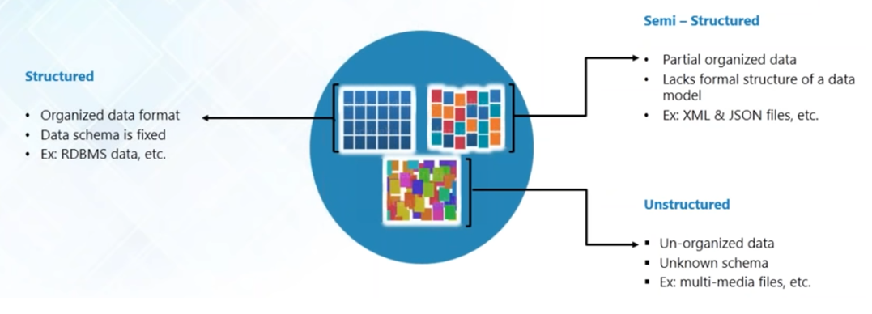
Problem 2: Processing Data with Complex Structures

Slide 21
Challenges:
Variety
Complexity
Integration
Solutions:
Data Lakes
ETL and ELT Processes
Schema-on-Read
Notes:
Processing Data with Complex Structures
Challenges:
Variety: Data comes in various forms, such as structured, semi-structured, and unstructured.
Complexity: Integrating and processing data with different formats and structures is complex.
Integration: Combining data from various sources while maintaining data quality and consistency.
Solutions:
Data Lakes: Use data lakes to store raw data in its native format, allowing for flexibility in processing.
ETL and ELT Processes: Employ Extract, Transform, Load (ETL) or Extract, Load, Transform (ELT) processes to manage data variety.
Schema-on-Read: Implement schema-on-read approaches to handle unstructured data flexibly.

Slide 22
Case Study :Company: Twitter
Challenge:
Data Variety: Twitter processes vast amounts of diverse data, including tweets, images, and videos, leading to challenges in integrating and analyzing these different data types.
Solution:
Data Lake Implementation: Twitter built a data lake using Hadoop, enabling the storage of raw data in its native format.
Unified Data Platform: Developed a unified data platform, integrating various data processing tools like Apache Pig, Hive, and Presto to handle structured and unstructured data.
Outcome:
Flexibility: The data lake allowed Twitter to store and process diverse data types efficiently without extensive upfront modeling.
Improved Insights: By integrating multiple data processing tools, Twitter enhanced its ability to analyze complex data, improving insights into user behavior and engagement.

Slide 23
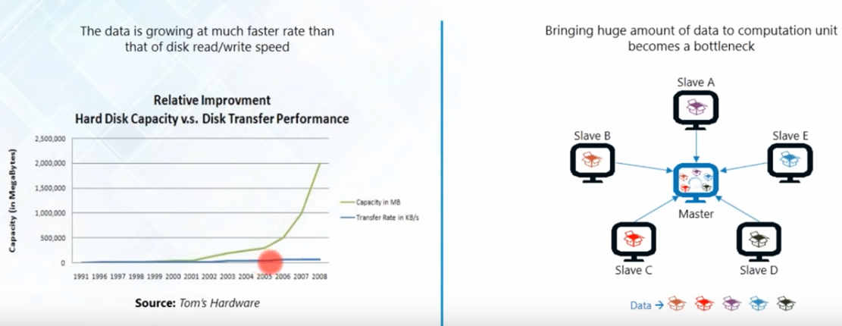
Problem3 : Processing Data Faster

Slide 24
Challenges:
Velocity
Real-Time Processing
Latency
Solutions:
In-Memory Computing
Stream Processing
Parallel Processing
Notes:
Challenges:
Velocity: The speed at which data is generated and needs to be processed can overwhelm traditional systems.
Real-Time Processing: Demand for real-time data processing for timely insights and decision-making.
Latency: Reducing latency to ensure faster data processing and retrieval.
Solutions:
In-Memory Computing: Use in-memory computing frameworks like Apache Spark for faster data processing.
Stream Processing: Implement stream processing frameworks like Apache Kafka and Apache Flink for real-time data processing.
Parallel Processing: Utilize parallel processing to distribute computational tasks across multiple nodes.

Slide 25
Case Study :Company: Uber
Challenge:
Real-Time Data Processing: Uber needed to process real-time location and transactional data from millions of rides to provide accurate ETAs, dynamic pricing, and efficient matching.
Solution:
Stream Processing: Uber adopted Apache Kafka and Apache Flink for real-time data streaming and processing, enabling rapid analysis of incoming data.
In-Memory Computing: Leveraged Apache Spark for in-memory data processing, reducing latency and improving data processing speed.
Outcome:
Real-Time Insights: Uber was able to process and analyze data in real-time, enhancing the accuracy of its services and customer experience.
Reduced Latency: Achieved faster data processing and retrieval, allowing for immediate responses to changing conditions and user demands.

Slide 26
A big data analytics cycle can be described by the following stage −
Business Problem Definition
Data Identification
Data Acquisition & Filtering
Data Extraction
Exploratory Data Analysis
Data Preparation for Modeling and Assessment
Data Visualization
Analysis of Results

Slide 27
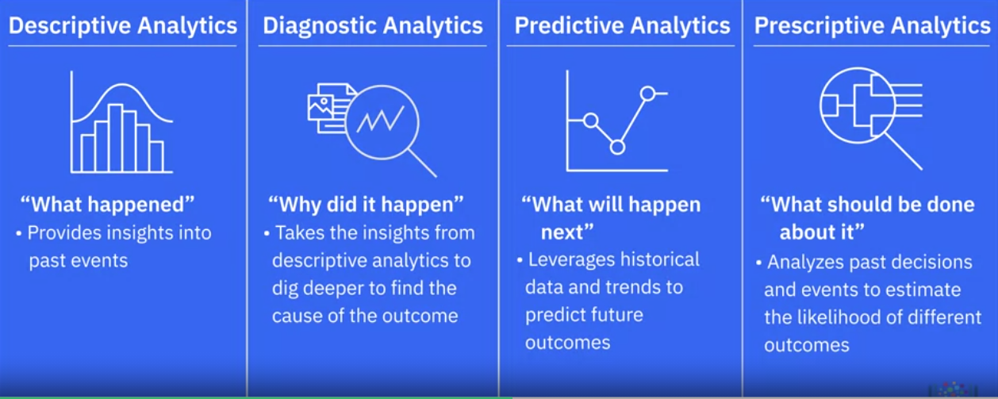
Classification of Data Analytics
Notes:
Descriptive
“Yesterday between 5 PM and 7 PM, traffic speed on Highway X dropped to 20 km/h due to heavy congestion.”
Disgnostic
Traffic jam occurred because two lanes were closed for roadwork and an accident happened near Exit 12
Predictive
“There is an 80% chance of congestion tomorrow at 8 AM on Highway X because it’s Monday and rain is predicted.”
Prescriptive
“Divert 30% of vehicles to an alternate route and adjust traffic signals to reduce congestion by 25%.”

Slide 28
Retail Case Study: Walmart
Walmart, one of the largest retail chains in the world, uses various types of analytics to optimize its operations and improve customer satisfaction.
Descriptive Analytics:
Question: "What happened?"
Example: Walmart employs descriptive analytics to monitor sales data and inventory levels across its stores. By analyzing historical sales patterns, Walmart identifies that certain products, like snow shovels and winter clothing, experience higher demand during the winter season in northern regions.
Diagnostic Analytics:
Question: "Why did it happen?"
Example: To understand the factors contributing to the spike in sales of specific products, Walmart uses diagnostic analytics. They discover that the increase is due to weather conditions, local events, and regional holidays, which drive customers to purchase specific items more frequently during these times.
Predictive Analytics:
Question: "What will happen next?"
Example: Walmart leverages predictive analytics to forecast future demand for products based on historical sales data and external factors like weather forecasts. For instance, they predict a surge in demand for emergency supplies ahead of an anticipated hurricane in the southeastern United States.
Prescriptive Analytics:
Question: "What should be done about it?"
Example: Using prescriptive analytics, Walmart determines the best actions to take to optimize supply chain operations. They decide to increase the stock of high-demand products in affected areas, adjust pricing strategies, and enhance logistics to ensure timely delivery. Additionally, they launch targeted marketing campaigns to promote relevant products to customers likely to be affected by the hurricane.

Slide 29
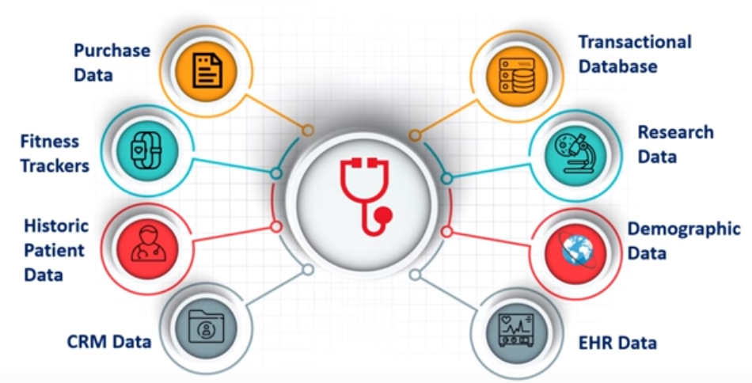
Big data Analytics-Case studies
Healthcare

Slide 30
Traditional Vs Big data Approach
OLTP: Online Transaction Processing
DBMSs
OLAP: Online Analytical Processing
Data Warehousing
RTAP: Real-Time Analytics Processing
Big Data Architecture & Technology

Slide 31
